Slide 3
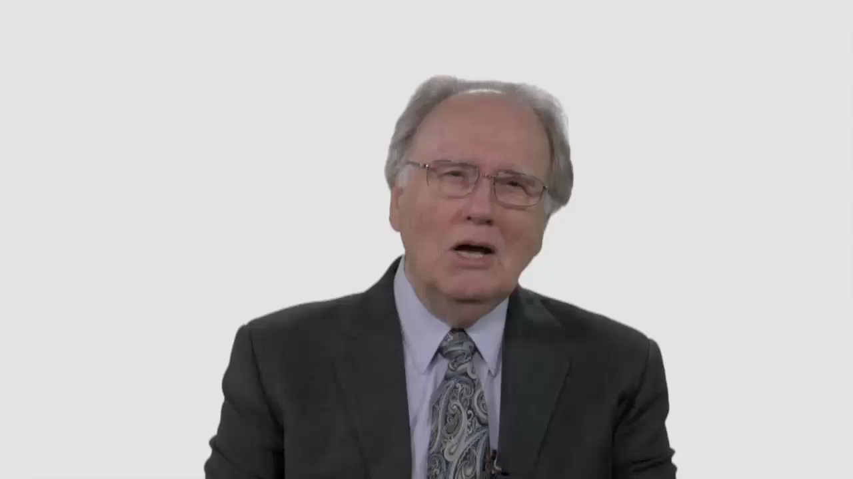

Slide 4
Have Your Say.
What does Ellen White’s
ministry mean to you?

Slide 5
Have Your Say.
What books, experiences,
or people have helped shape
your feelings about Ellen White?

Slide 6
Conversation Builders.
Can you think of examples
where we’ve failed to use
common sense in interpreting
Ellen White’s counsels?

Slide 7
Conversation Builders.
How would you respond to
inquiries about the role of Ellen
White in the Adventist Church?

Slide 8
Discussion Questions.
Ellen White herself warned that
her counsels shouldn’t be treated
as an addition to scripture, why do
we sometimes act as if they are?

Slide 9
Discussion Questions.
What’s the best way to introduce
teens to the writings of Ellen White?

Slide 10
Discussion Questions.
How do you react to the idea
of modern adaptations of
Ellen White’s books into
today’s language?

Slide 11
What Now?
Could your congregation be
more deliberate in educating
people about the relevance of
Ellen White’s counsels today?

Slide 12
What Now?
What approaches would best help
your young people develop an appreciation for the spiritual
treasures of Ellen White’s writings?

